Slide 1
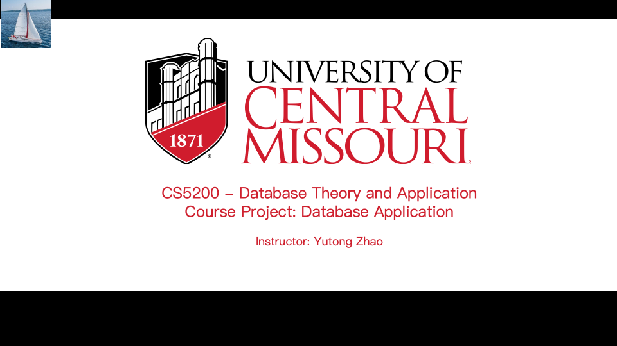

Slide 2


GROCERY INVENTORY MANAGEMENT SYSTEM
01
PURPOSE OF THE DATABASE
02
DATABASE OBJECTIVES
03
IDENTIFYING THE USERS AND THEIR NEEDS
04
INPUT DATA AND STORED INFORMATION
05
ER DIAGRAM
06
ROLES OF GROUP MEMBERS
07
ADVANCED FEATURES
08
CRUD OPERATIONS
09
SECURITY MEASURES

Slide 3

PURPOSE OF THE DATABASE
The purpose of the database is to serve as the backbone of the grocery inventory management system. It ensures real time data management, avoiding redundancy, and facilitates accurate inventory tracking and transaction management. The database is essential for maintaining consistency and operational efficiency.

Slide 4



DATABASE OBJECTIVES
The database should:
- Manage user authentication and authorization.
- Store and update product information.
- Track orders and order details.
- Support concurrent operations ensuring data integrity.

Slide 5

IDENTIFYING THE USERS AND THEIR NEEDS
Users:
1. Admins: Full access to manage inventory, orders, and users.
2. Staff: Limited access for viewing products and assisting customers.
Functions:
- Admins manage products, orders, and user roles.
- Staff view product information and assist in operations.

Slide 6


INPUT DATA AND STORED INFORMATION
Input Data:
- User credentials and roles.
- Product details: Name, category, price, stock.
- Orders and order items.
Stored Information:
- User details.
- Product inventory.
- Transaction and order data.

Slide 7
ER DIAGRAM
ENTITIES:
- USERS: USER CREDENTIALS AND ROLES.
- PRODUCTS: PRODUCT INVENTORY DETAILS.
- ORDERS: TRANSACTIONS LINKING USERS TO PRODUCTS.
- ORDER ITEMS: DETAILED PRODUCT QUANTITIES IN ORDERS.
RELATIONSHIPS:
- USERS TO ORDERS: ONE-TO-MANY.
- ORDERS TO ORDER ITEMS: ONE-TO-MANY.
- ORDER ITEMS TO PRODUCTS: MANY-TO-ONE.

Slide 8
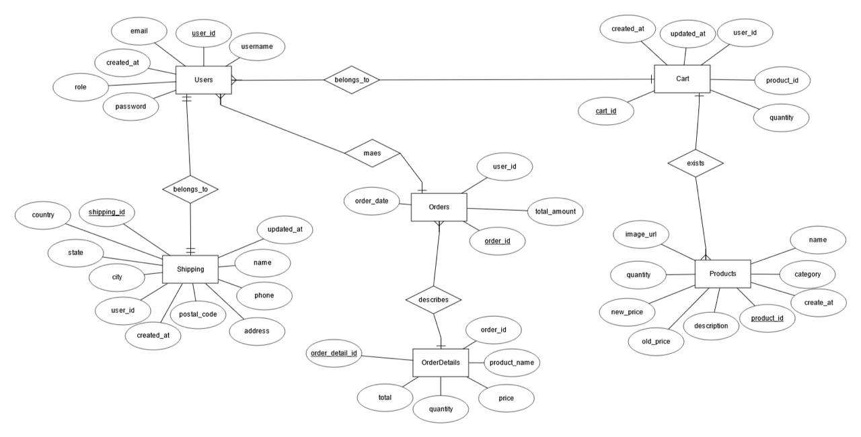

Slide 9
ROLES FOR GROUP MEMBERS
1. SCHEMA DESIGNER: CREATES THE DATABASE SCHEMA AND ER DIAGRAM.
2. BACKEND DEVELOPER: IMPLEMENTS CRUD OPERATIONS AND TRANSACTION MANAGEMENT.
3. FRONTEND DEVELOPER: DESIGNS THE GUI WITH BOOTSTRAP.
4. SECURITY SPECIALIST: ENSURES SECURE PASSWORD HASHING AND ROLE-BASED ACCESS.
5. TESTER: TESTS CONCURRENCY AND SYSTEM FUNCTIONALITY.

Slide 10
ADVANCED FEATURES
- TRANSACTION MANAGEMENT: ENSURES DATA INTEGRITY DURING OPERATIONS.
- ROLE-BASED ACCESS CONTROL: RESTRICTS SENSITIVE ACTIONS TO ADMINS.
- SCALABILITY: PREPARED FOR DATA WAREHOUSING AND ANALYTICS IN FUTURE ITERATIONS.

Slide 11
CRUD OPERATIONS
- CREATE: ADD NEW PRODUCTS AND ORDERS.
- READ: VIEW PRODUCTS AND ORDER DETAILS.
- UPDATE: MODIFY PRODUCT OR ORDER DETAILS.
- DELETE: REMOVE OBSOLETE DATA.
-CRUD OPERATIONS ARE RESTRICTED TO ADMINS FOR SECURITY.

Slide 12

SECURITY MEASURES
- PASSWORD HASHING: SECURE STORAGE USING HASHING ALGORITHMS.
- ROLE-BASED ACCESS CONTROL: LIMITS SENSITIVE ACTIONS TO ADMINS.
- INPUT VALIDATION: PREVENTS SQL INJECTION AND OTHER ATTACKS.
- SESSION MANAGEMENT: MAINTAINS SECURE USER SESSIONS.

Slide 13



